Slide 1
Reading with your child
EYFS

Slide 2
What makes a skilled and confident reader?
Opportunities to:
Learn about print and books
Learn about the sounds in spoken language (this is called phonological awareness)
Learn about the letters of the alphabet and how they come together to form words.
Listen to books read aloud
Every one of these elements is vital!

Slide 3
Learn about print and books
We use books in certain ways:
Hold them the right way up
Turn pages one at a time
Read L-R
Print Awareness
Print is all around us
Home and outside environment

Slide 4
Sounds and words in spoken language
Rhyming
Alliteration
Voice and environmental sounds
Tuning into phonemes
Blending and Segmenting
Phonological awareness – tune into and work with sounds of spoken language

Slide 5
Listening to books read aloud
Reading aloud = single most important activity for building knowledge required for success in reading (and writing!).
Reading aloud supports:
Self esteem
Positive attitudes/social values
Development of rich vocabulary
Develops listening and attention skills
Make connections between spoken/written words
Profile of reading – shows its important to us as adults!
Children learn the JOY of reading!
All children - Keep doing this until they leave school!!!!

Slide 6
Engagement and Enjoyment
What is a literacy rich environment?
How many different types of print are on offer at home?
cards
chapter books
menus
newspapers
emails
non-fiction
picture books
magazines
catalogues
recipe books
letters
atlases
programmes
shopping lists
comics
food packets
poetry

Slide 7
Literacy rich home environment
How?
Establish a regular time (before bed/bath time works well)
Keep a large variety of reading materials at hand
Store books/materials in places children can access
Share your love of books with them/the joy of reading!
Have paper and writing tools available along side
Model reading and writing for pleasure
Make time for conversations about books and reading
Use board games to reinforce language/literacy skills

Slide 8
Engaging your child
Build a home library
Let your child choose the book
Use funny voices!
Tap into their interests
Take books with you on journeys or shopping trips
Use technology to your advantage – active learn

Slide 9
In school at the moment..
Pre-Covid…
we would send home picture books to start. no text. Encourages children to use pictures as clues to tell the story. Builds confidence in reading ability. Adults need to model to begin with. Adults model a wide range of language for children to use.
Then..
When children have learnt S,a,t,p,i,n,m and d they will get their first books with words and small sentences.
These books need to be read at least 3 times for children to be secure.
At the moment we wont be sending books home, instead you will receive an active learn login for your child to access reading books online. Children can earn rewards and play games on the active learn after reading.

Slide 10
Supporting your child with reading
Reception
Phonics: children in Reception will be learning Phase 2, Phase 3 and Phase 4.
Banded books are decodable so allow children to practice segmenting a word by saying the pure sounds and then blending it back together.
There are some words that cannot be decoded. These are words that children just have to know by sight. (the, I, into, into, no, go, so etc.)

Slide 11
Supporting your child with reading
Use phonics first – saying the sound/doing the action.
Use ‘book talk’ – talk about stories and story language, key features of the book, word level – words, sentences, punctuation, features on the page e.g. speech bubbles
Check understanding – encourage use of picture clues to help understanding, also show your child how you might be able to predict the meaning from other word clues.
Use question prompts to help deepen your child’s understanding and support their reading development
Model by reading them a story.

Slide 12
Supporting your child with reading
Extra support:
TALK TALK TALK! To your children.

Slide 13
YOU reading aloud to your child shows you value reading.

Slide 14
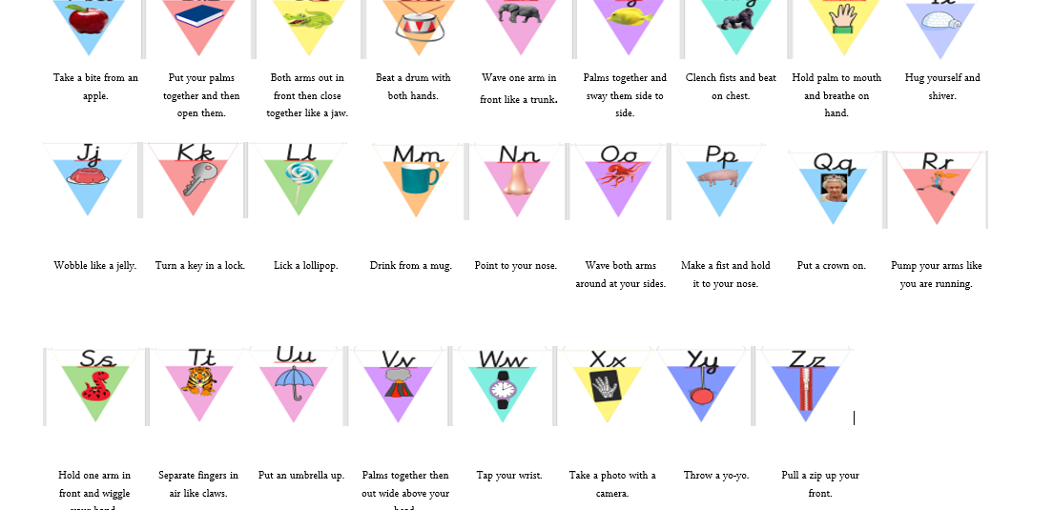
New actions

Slide 15
Active learn – online reading books. I will Dojo message you. Your child's unique login details.

Slide 16
EARLY ADOPTER EYFS
This year we have become an early adopter school for the new EYFS framework that becomes statutory next year 2021.
Extra information about the early adopter is posted on the school website- under Swallow Class.

Slide 17
Questions….

